Slide 1
Lab of Signals and Systems Introductions

Slide 2
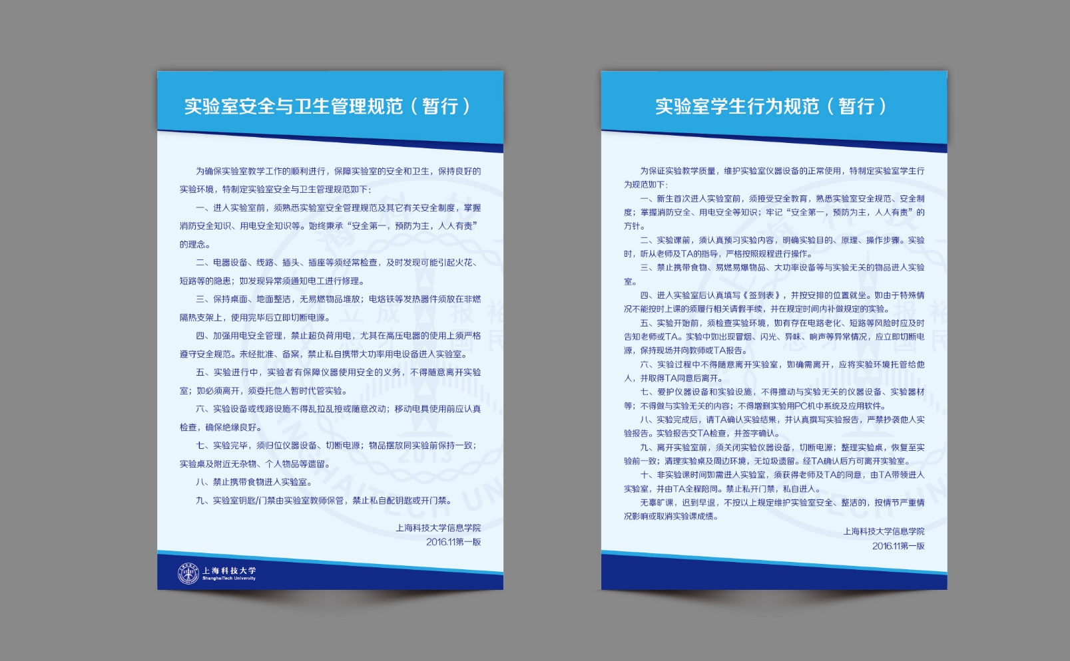
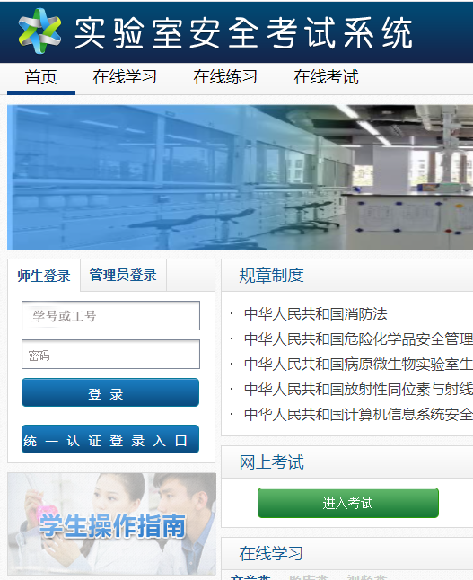
实验室安全
http://etest.shanghaitech.edu.cn/

Slide 3
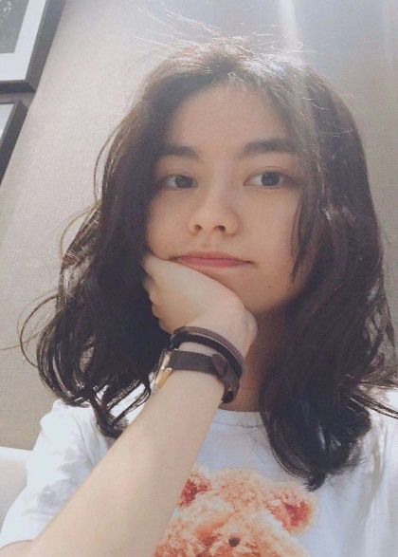
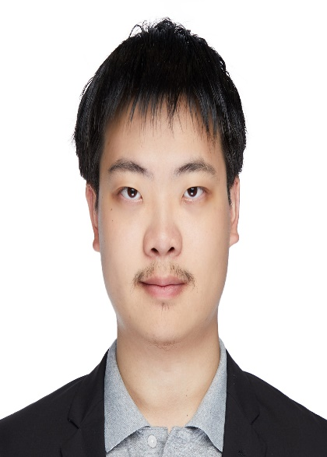
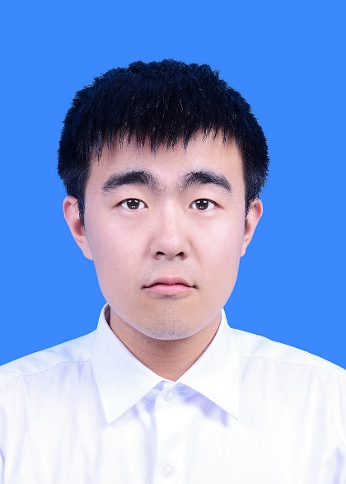
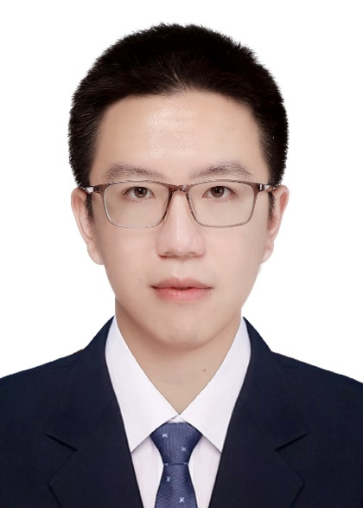
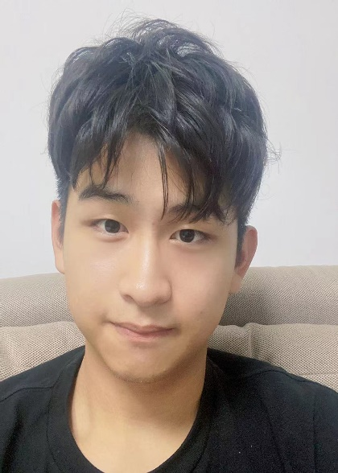
Teaching Team
陆林燕
luly
15618296017
张叶歆
zhangyx5
罗剑文
Luojw
张汉中
Zhanghzh
宋睿博
songrb
郑一诺
zhengyn
@shanghaitech.edu.cn

Slide 4
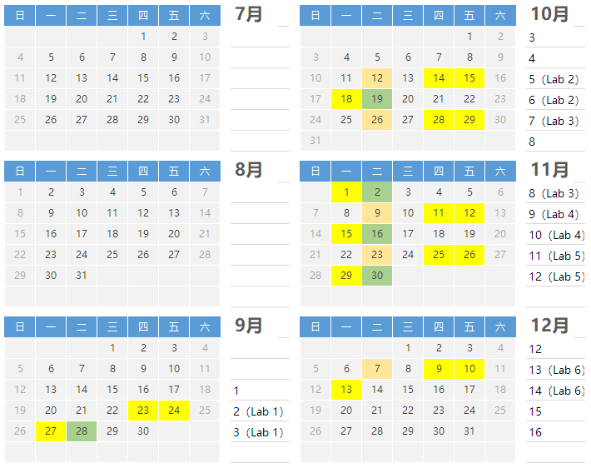
Time Table
Laboratory
class time
Release
preview materials
Submit your preview report
Class time:
Mon., Thurs., Fri.
1:00-15:45 pm

Slide 5
About Class and Grading
6 labs are included in the course.
Every lab (except lab1) will consist of a preview report and a lab report.
The final score consists of all the preview reports and lab reports.
Lab 1 |  | Lab 2 |  | Lab 3 |  | Lab 4 |  | Lab 5 |  | Lab 6
0 | 10 | 4 | 14 | 4 | 14 | 4 | 14 | 4 | 14 | 4 | 14
Tips:
The preview report will be published and submitted on BB. Please note the submission deadline. No waiting for expiration.
The lab report needs to be completed in class. The deadline for submission is 16:00. No waiting for expiration.
Please attend every class, otherwise you will lose your report points. If something happens, please ask for a transfer to the other two days of class temporarily.

Slide 6
About report
Preview report:
Preview report should be finished independently. Each student is required to submit his/her own preview report.
No code is required in the preview report.
Internet is allowed, but plagiarism is not allowed. Answer the questions yourself.
Lab report:
Submit one copy for each group.
The scope of discussion is limited to the group. Please raise your hand to seek help from the teacher or TAs, not from other groups.

Slide 7



诚信
花时间了，多少学点东西
至少本Lab的成绩取消，课程成绩可能取消
课程不难，预习+听课肯定没问题
课程档案中会留有记录
老师和助教们都很nice
抄袭者和被抄袭者同样处理，不接受说明
……

Slide 8

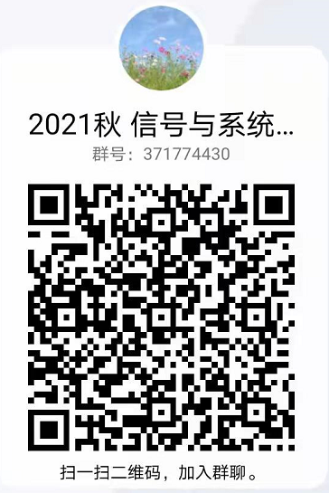
Interactive
2021 秋 EE150L
信号与系统
实验
371774430
课程通知、资料发布
预习报告发布、提交
讨论答疑：论坛
通用问题交流
课程资料发布
沟通交流

